Slide 1


Project Title: Smart Attendance Management System Using Face Recognition
Project Group: BI4-3 & Project Group Details
Sr. No. | Roll no. | Student full name (surname-first name-middle name)
1 | 18 | Kakade Juily Sharadkumar
2 | 28 | Jain Nemish
3 | 24 | Patel Md Ikhlas Shakeel
4 | 17 | Gaibu Israr Iqbal
5 | 47 | Valsangkar Sakib Ahmed Salim Ahmed
Under the guidance of
Guide Name: Mr. Anil S. Naik
Email Id: asnaik@witsolapur.org
Designation: Assistant Professor
Walchand Institute of Technology, Solapur
(www.witsolapur.org)

Slide 2

Idea of project in detail
Smart Attendance Management System Using Face Recognition is developed for daily employee attendance for Tara Paints & Chemicals Industry. It includes following features:
It facilitates to access the information of all the employee in company.
It automates the process of attendance of a employee using Face Detection and Recognition.
It facilitates to access the attendance information of a all employee through admin dashboard.
Generation of Monthly Attendance is stored in Excel format.

Slide 3
Background of project
Attendance in company is generally paper based which may sometimes cause errors. Taking attendance manually consumes more time. So, the proposed attendance system uses Facial recognition technology to take attendance.
The Enrollment of employee's biometric details is a one-time process and details store in a database.
Attendance is marked after employee identification. You can have your employee id which will be unique for each employee. The presence of each employee will be updated in a database. This results in improved performance over the manual attendance management system.
This product acts as a solution with more accurate results in a user interactive manner rather than existing attendance management systems.
In this system, we have used Haar Cascade classifier and LBPH algorithm to detect and recognize the face of a particular employee.

Slide 4
System architecture
Start
GUI Based Menu System
Admin Panel
Mark Attendance
Add/Update Employee
Face Recognition using LBPH
Train Images
Attendance Result
Generate report
Database
End
Update Attendance to MS Excel
End

Slide 5
Methodology (working)
Admin
Add Details/Face images
Report
Database
Employee
Mark Attendance

Slide 6
We have two panels 1st is admin panel which is only accessible for admin and 2nd is mark attendance which is accessible for employee.
Admin Panel
In this module, Admin can Add/Update/Delete the Employee details and also Department, whereas he can train the employee images and generate report.
Creating Face Dataset
In this module, the webcam captures the images of the employee in order to create a dataset of 60 images of various positions of their face.
Train the Image Dataset
The dataset is trained using machine learning algorithm and a training data file is created.
Generate Report
In this module the information in the updated database is imported and then converted to a MS Excel file and generation of the attendance report for that month with total count.
Mark Attendance
In this module, the webcam captures the image of the employee and identifies the person and sets the attendance as present and the database is updated with the information.

Slide 7



Technology stack
Platform | Desktop Application
Hardware Required | Computer System, Camera
Technology | Python libraries, OpenCV
Software | PyCharm
Domain | Computer Vision, Machine Learning

Slide 8
Results
The software stores the faces that are detected and automatically marks attendance.
The software can be used for security purposes in organizations and in restricted zones.
The system is convenient and secure for the users and organization.
Software can be used to maintain records and generate reports.
It saves their time and efforts.
Walchand Institute of Technology, Solapur
8

Slide 9
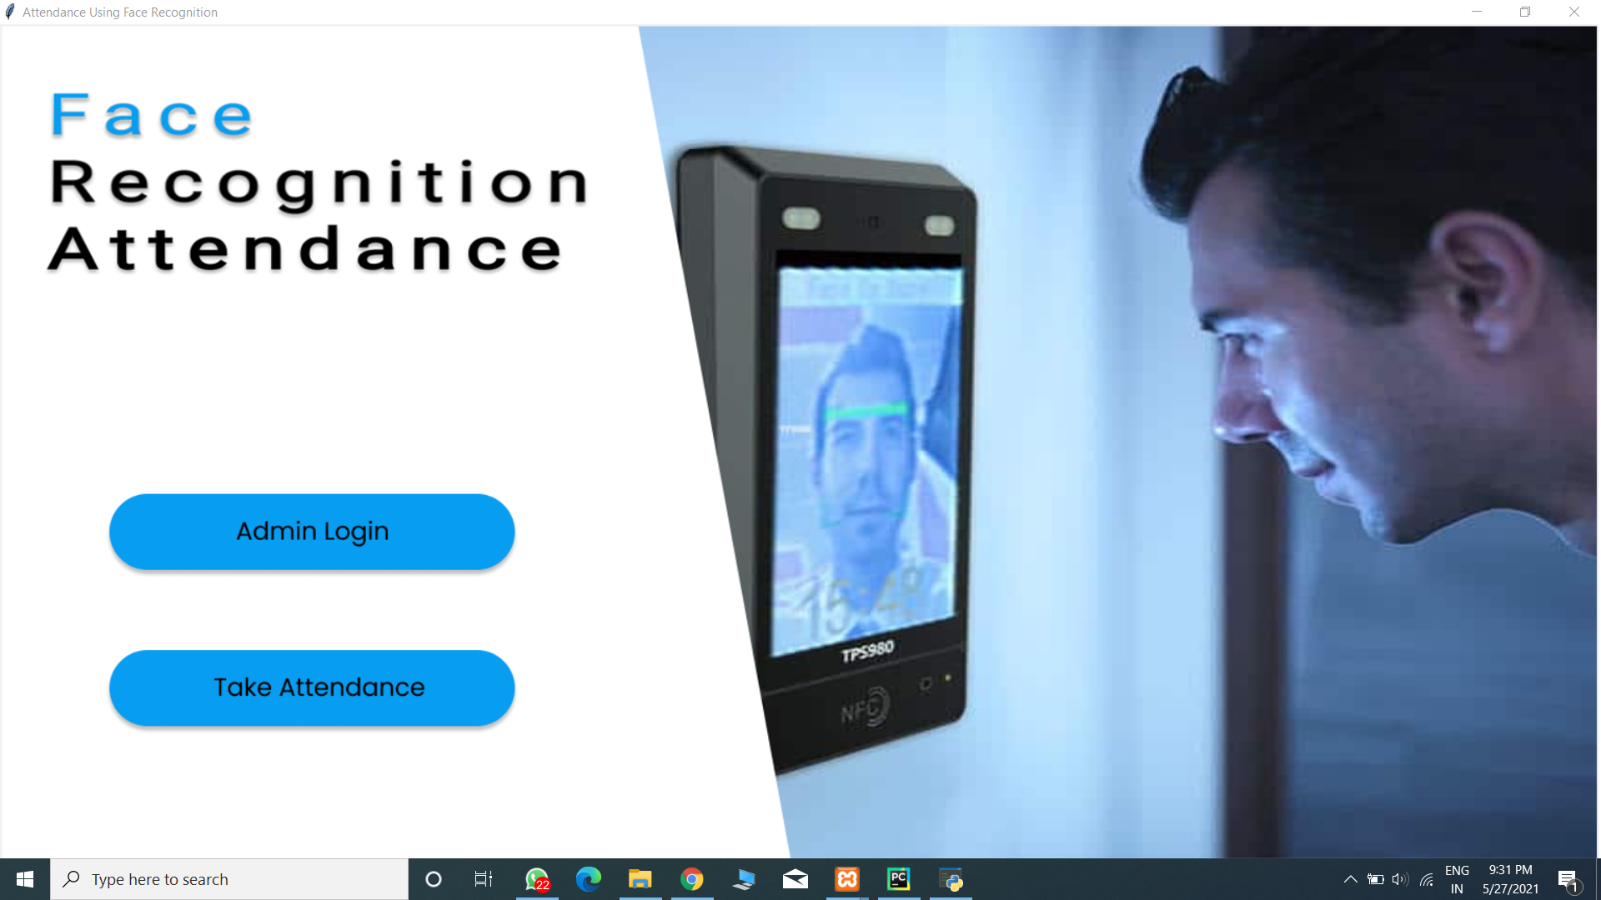
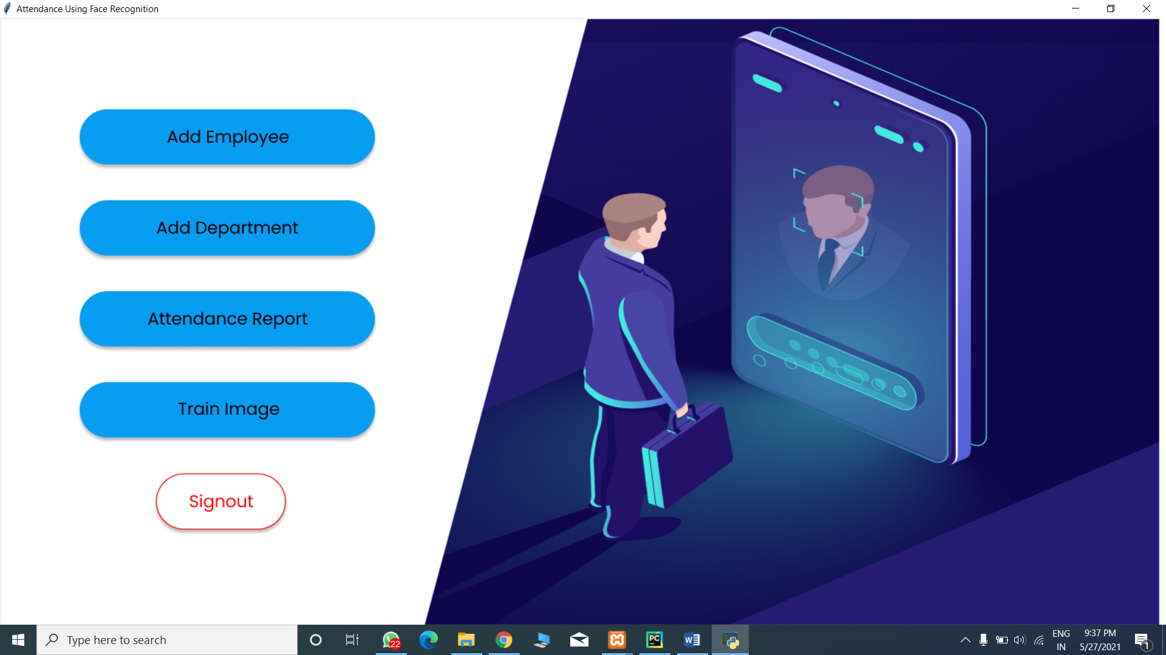
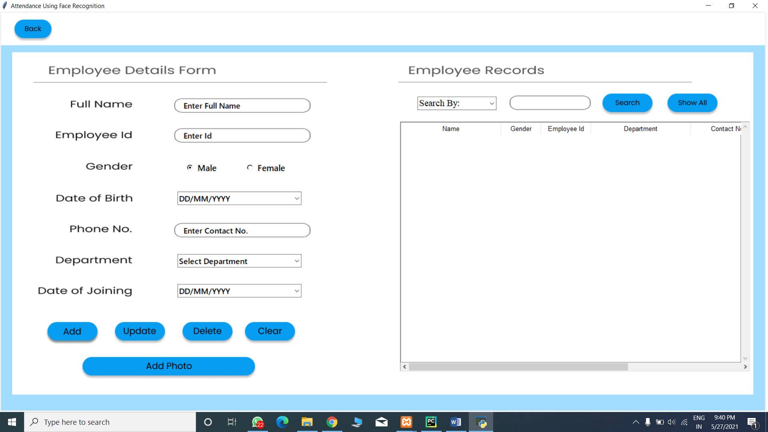
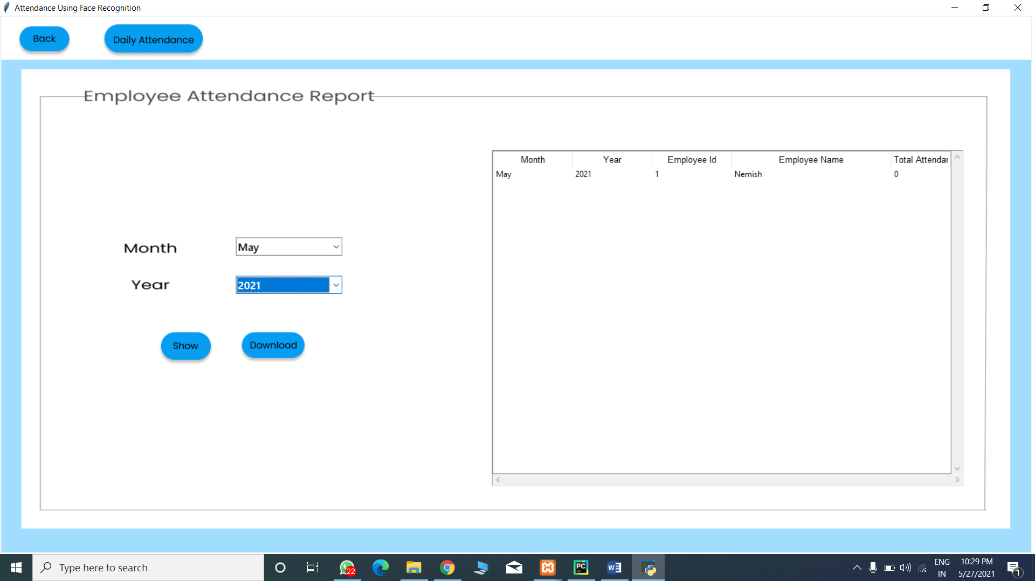

Slide 10
Conclusion
We have implemented an automated attendance system for a Tara Paints & Chemicals Industry Company by which they can record employee attendance.
Face recognition systems are currently associated with many top technological companies and industries making the work of face recognition easier.
The use of python programming and OpenCV makes it an easier and handy tool or system which can be made to anyone according to their requirement.
The proposed system discussed in this project will be helpful for many as it is a user-friendly and cost-efficient system.

Slide 11
Future scope
As it is prototype by using web camera and further we’ll install using hardware.
The scope of the project is the system on which the software is installed, i.e. the project is developed as a desktop application and it will work for a particular company but later it will be expanded to work for every sub branches.
The future work is to improve the recognition rate of algorithms when there are unintentional changes in a person like tonsuring head, using scarf, beard.

Slide 12
References
Shireesha Chintalapati, M.V. Raghunadh, Automated Attendance Management System Based on Face Recognition Algorithms, 2013 IEEE International Conference on Computational Intelligence and Computing Research
K. Goyal, K. Agarwal and R. Kumar, "Face Detection and tracking using OpenCV", International Conference on Electronics Communication and Aerospace
Stefano Arca, Paola Campadelli and Raffaella Lanzarotti, "A face recognition system based on automatically determined facial fiducial points", Pattern recognition, vol. 39.3, pp. 432-443, 2006
Ming Du, Aswin C. Sankaranarayanan, and Rama Chellappa, Robust Face Recognition from Multi-View Videos, IEEE TRANSACTIONS ON IMAGE PROCESSING, VOL.23, NO. 3, MARCH 2014.
14

Slide 13
Thank You !!!

